Slide 1
Mitobunny -A game to annotate Mitotic Cells
Srijeet Chatterjee , Mingxuan Gu, Zhaoya Pan, Wenyu Zhang, Muhammed Umer Raja
22nd July , 2019
Lecturers
Prof. Dr.-Ing. habil. Andreas Maier, Dr. rer. biol. hum. Ludwig Ritschl, Prof. Dr.-Ing. Joachim Hornegger

Slide 2

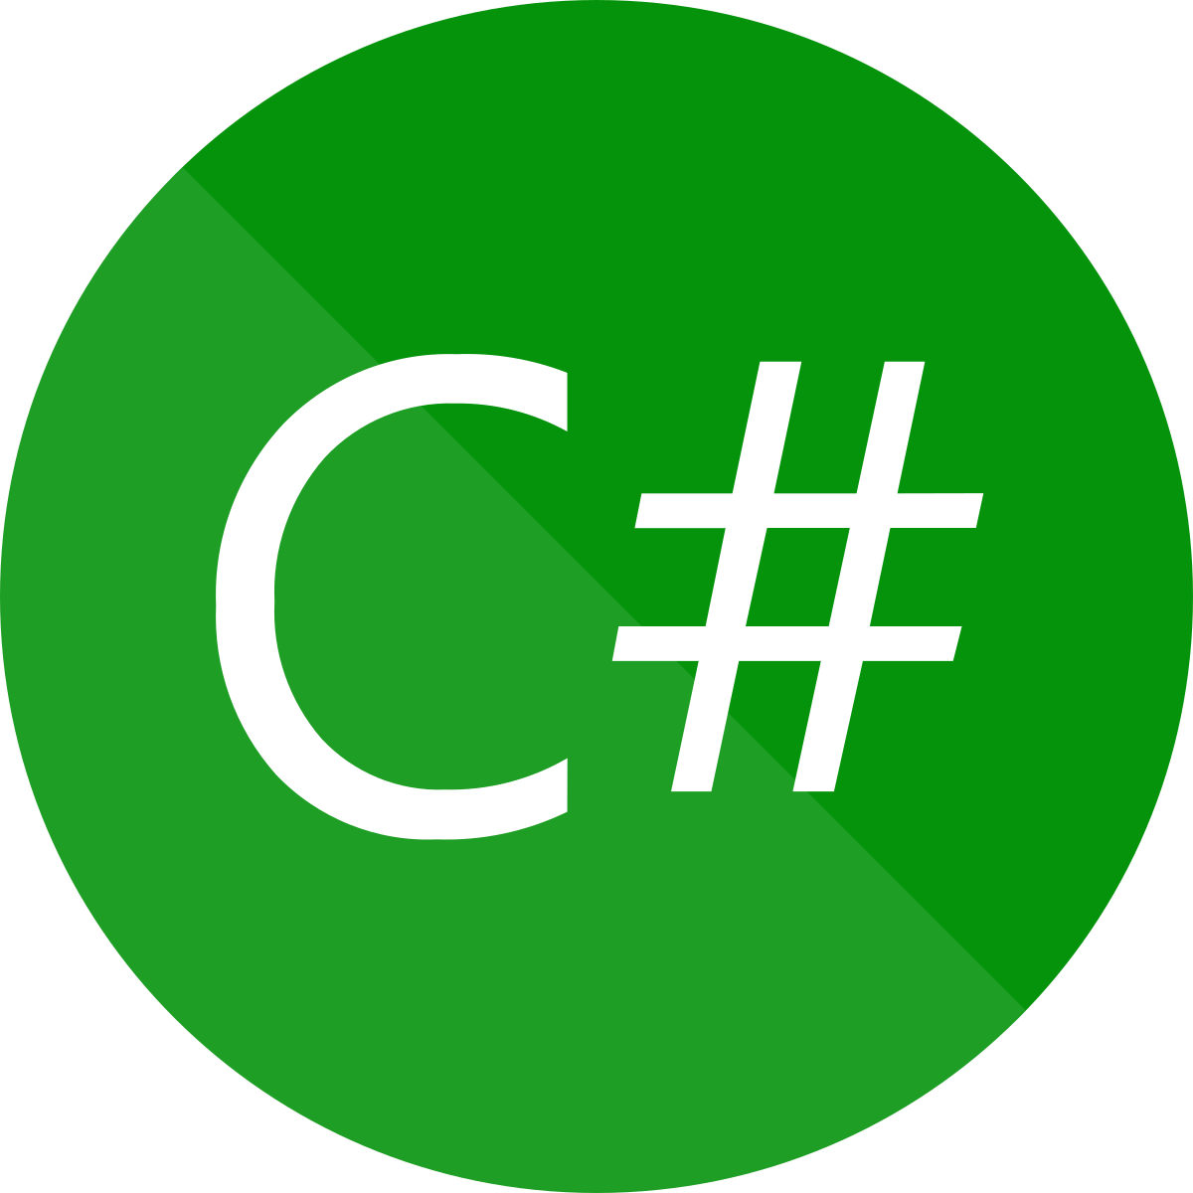
Platform

Slide 3
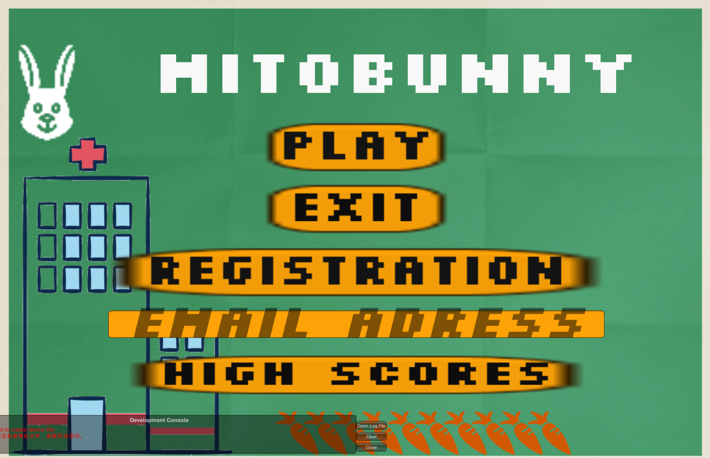
Mitobunny

Slide 4
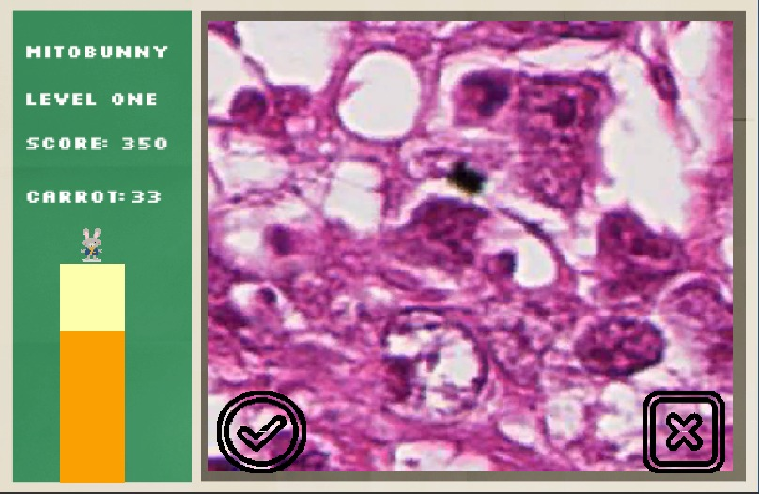
Mitobunny

Slide 5
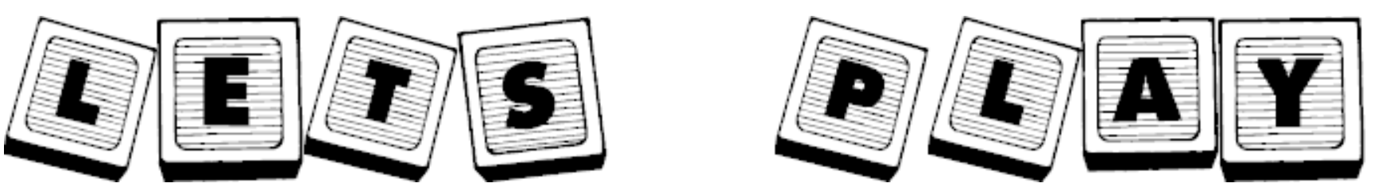

Slide 6
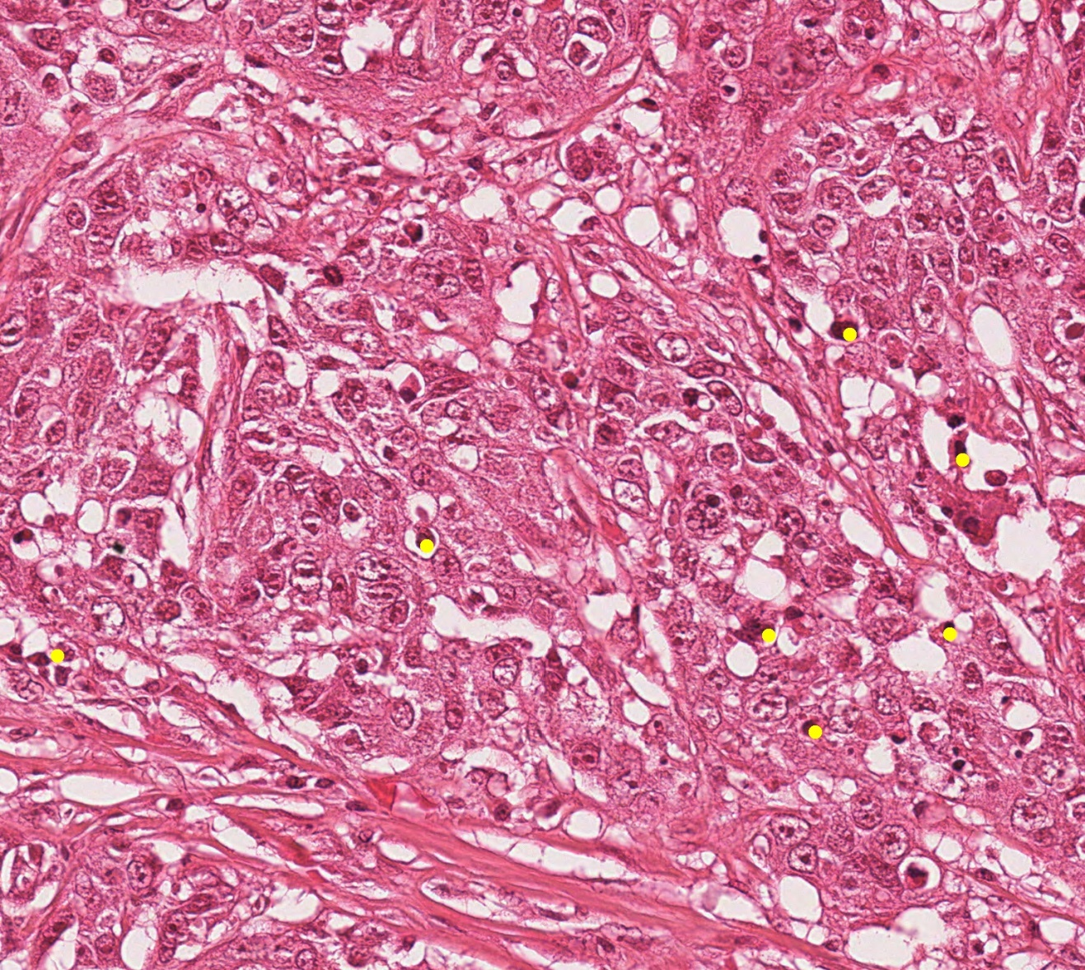
Database(mitosis images)
Notes:
The raw images from the grand challenge is 1539 * 1376
We think it is too hard for starters to detect mitosis. They may not even know where to look.
So we need to crop the images into small pieces

Slide 7
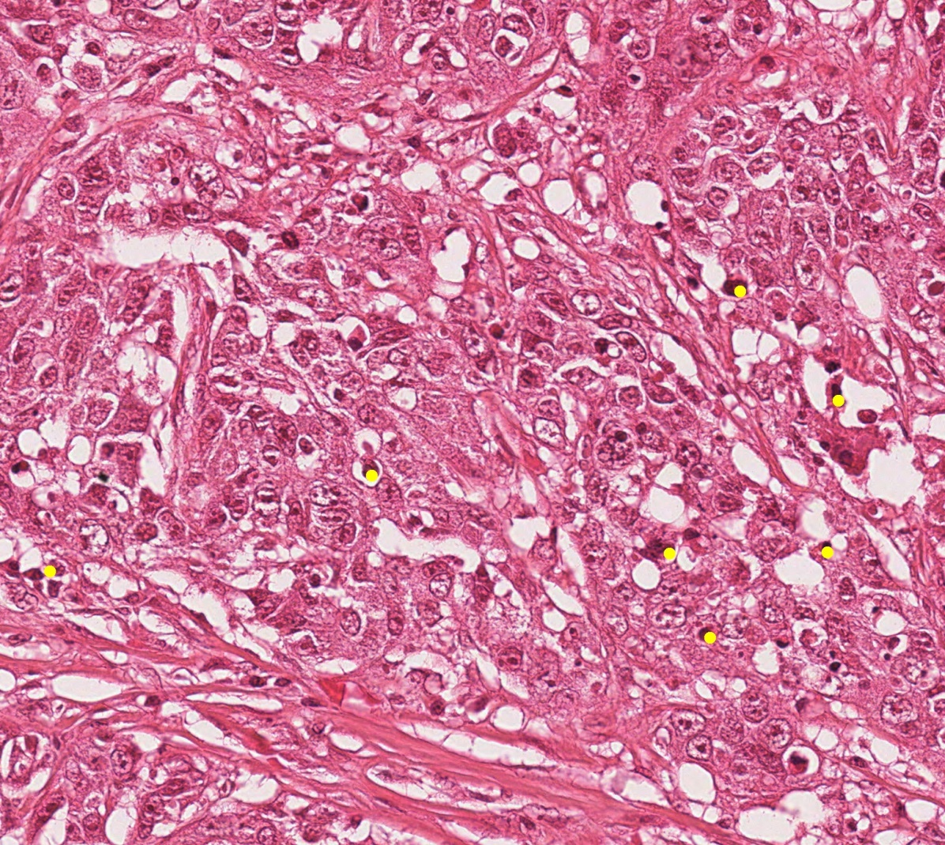
Database(mitosis images)
X
Y
1-Y
1-X
X, Y = Random(0 ,1)
Notes:
How do we crop the image?
we want the cropped image to be 256 * 256.
We want the mitosis cell or no mitosis cell appear anywhere in the cropped images, not only be well placed at the center.
We randomize the X, Y which is the distance from the chosen point to the left and upper border of the cropped image, so that the mitosis can appear at anywhere in the cropped image.
The new coordinate of mitosis is calculated by subtracting the original coordinate label by the coordinate of the top left vertices of the cropped image.

Slide 8
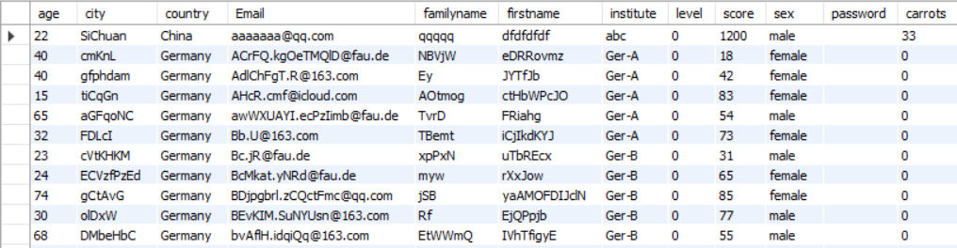
Database(user information)
Notes:
Email as primary key which means Email is an unique ID.
Why do we need age and institute? To make sure the labels are credible. For users whose age is below 18, younger users will have lower trust score.
Institute can also help to analyze if a user is credible enough.
Why do we have city, country? In the future, we can have leader board with respect to city and country. It will motivate our user to be more proactive in this game.
Except the database, we also save player data locally in the players 'device. The advantage of this is that whenever we request information, for example, get the score and carrot, we don’t need to query the database. It will save the time of response.

Slide 9
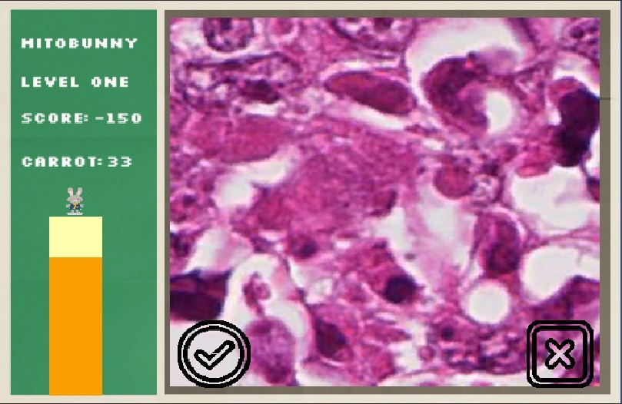
Scoring(L1):
Notes:
Correct: +100, time bar + 0.5
Incorrect: -50
Carrot: math.floor(max(score, 0)/100)

Slide 10
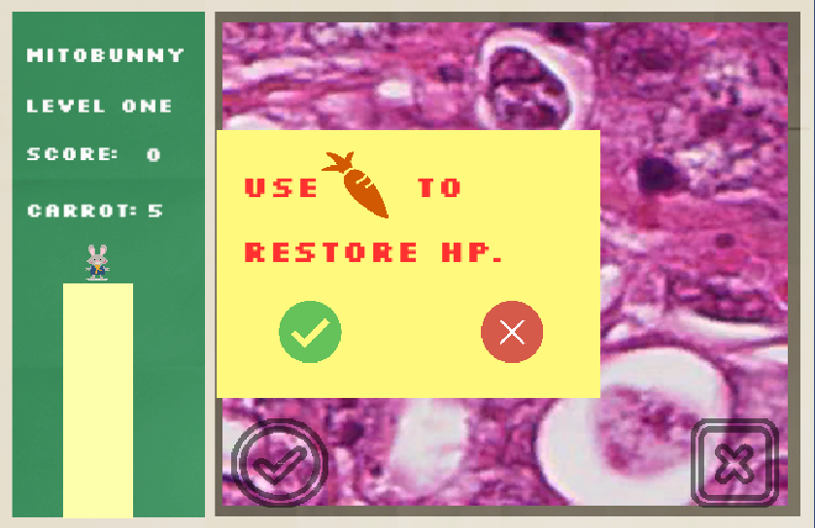
Scoring(L1):
Notes:
Use one carrot to restore all the time bar
If the user click the cross button, we settle the score and the carrot.

Slide 11
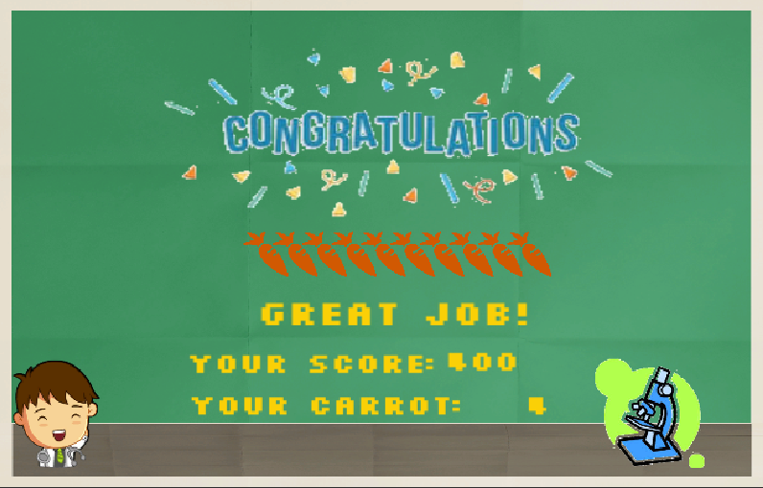
Scoring(L1):
Carrot: math.floor(max(score, 0)/100)
Notes:
Correct: +100, time bar + 0.5
Incorrect: -50
Carrot: math.floor(max(score, 0)/100)

Slide 12
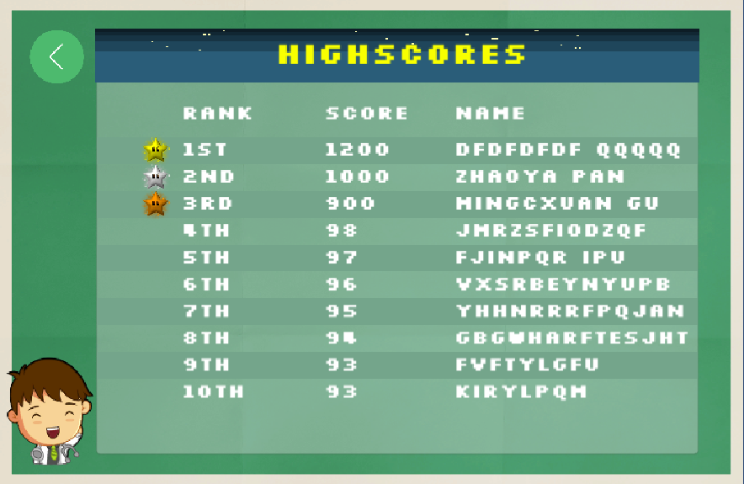
Leader Board:
Notes:
Connect to database
We use different background stripe for even and odd entries to make it more readable.
The leader board is ranked by score. The higher the score is, the higher the rank you get.
We would like to use leader board to motivate our user.
Besides, the rank is also a kind of factor showing how credible the user is. The higher rank the user has, the better the user performances while labeling the mitosis images.

Slide 13
So let’s recall our Objective:
Deep Learning-based algorithms showed great performance in many fields of image procession and pattern recognition and compete with technologies such as compressive sensing and iterative optimization. The basis for the success of these algorithms is the availability of large amounts of data (big data) for training and of high computing power (typically GPUs).
A major shortcoming is typically the number of labels that is required to train machine learning algorithms. Therefore, this project seminar will look into how to tackle this problem looking into topics of crowd-sourcing and gamification.
To arrive at good solutions also mobile game development will be a topic of interest. Aim of the seminar is to develop a prototype level for such a gamification-based crowd sourcing approach.

Slide 14
RECOGNITION PHASE:LEVEL-1

Slide 15
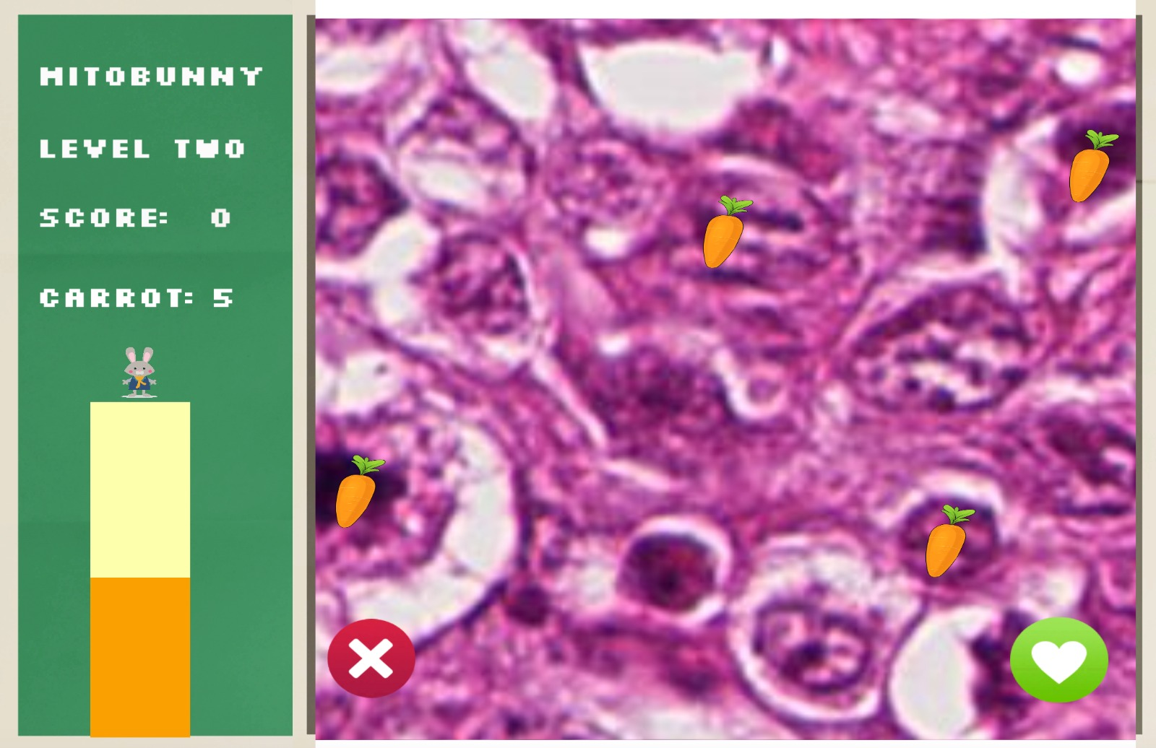
UNDERSTANDING PHASE: LEVEL-2

Slide 16
WHAT’S NEXT???

Slide 17
WHAT’S NEXT???
REAL GAME!!!!
LEVEL-3

Slide 18
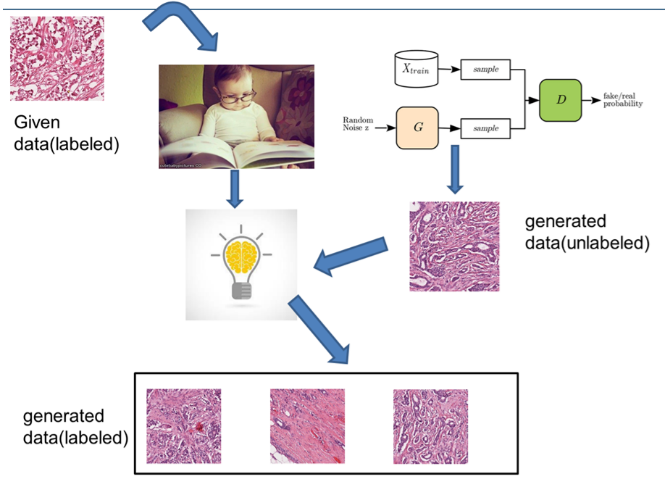
Data Generation and Annotation

Slide 19
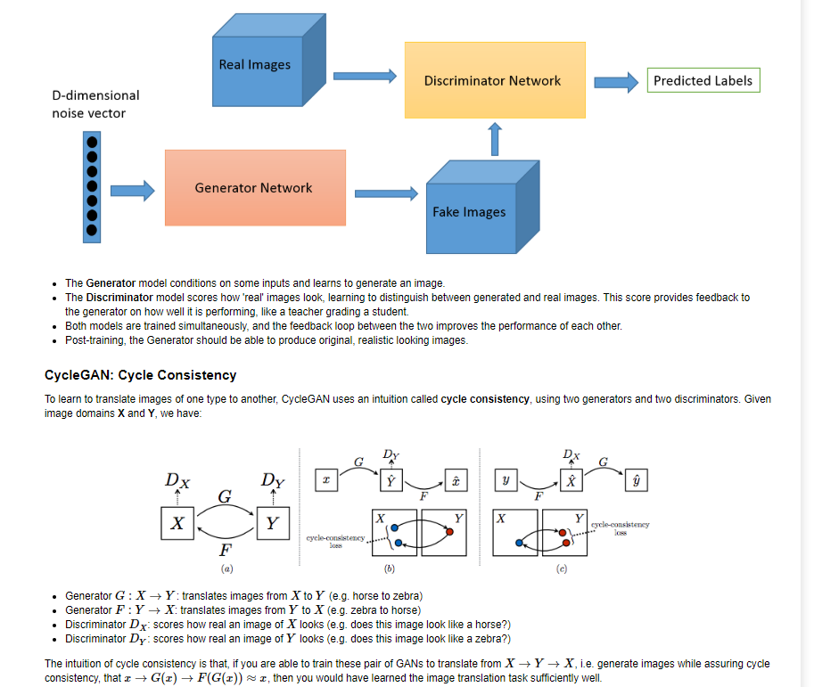
Cycle GAN

Slide 20
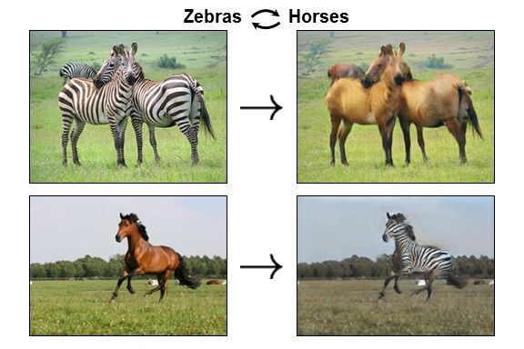
Expectation

Slide 21
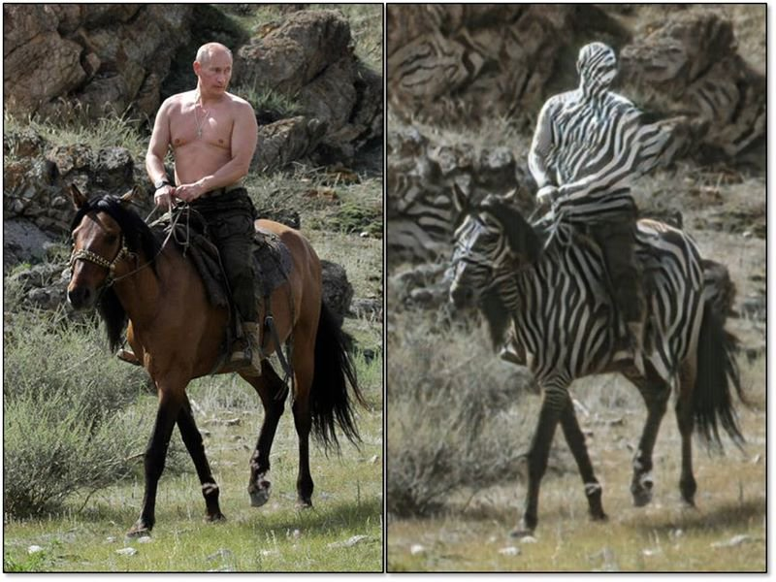
Reality

Slide 22
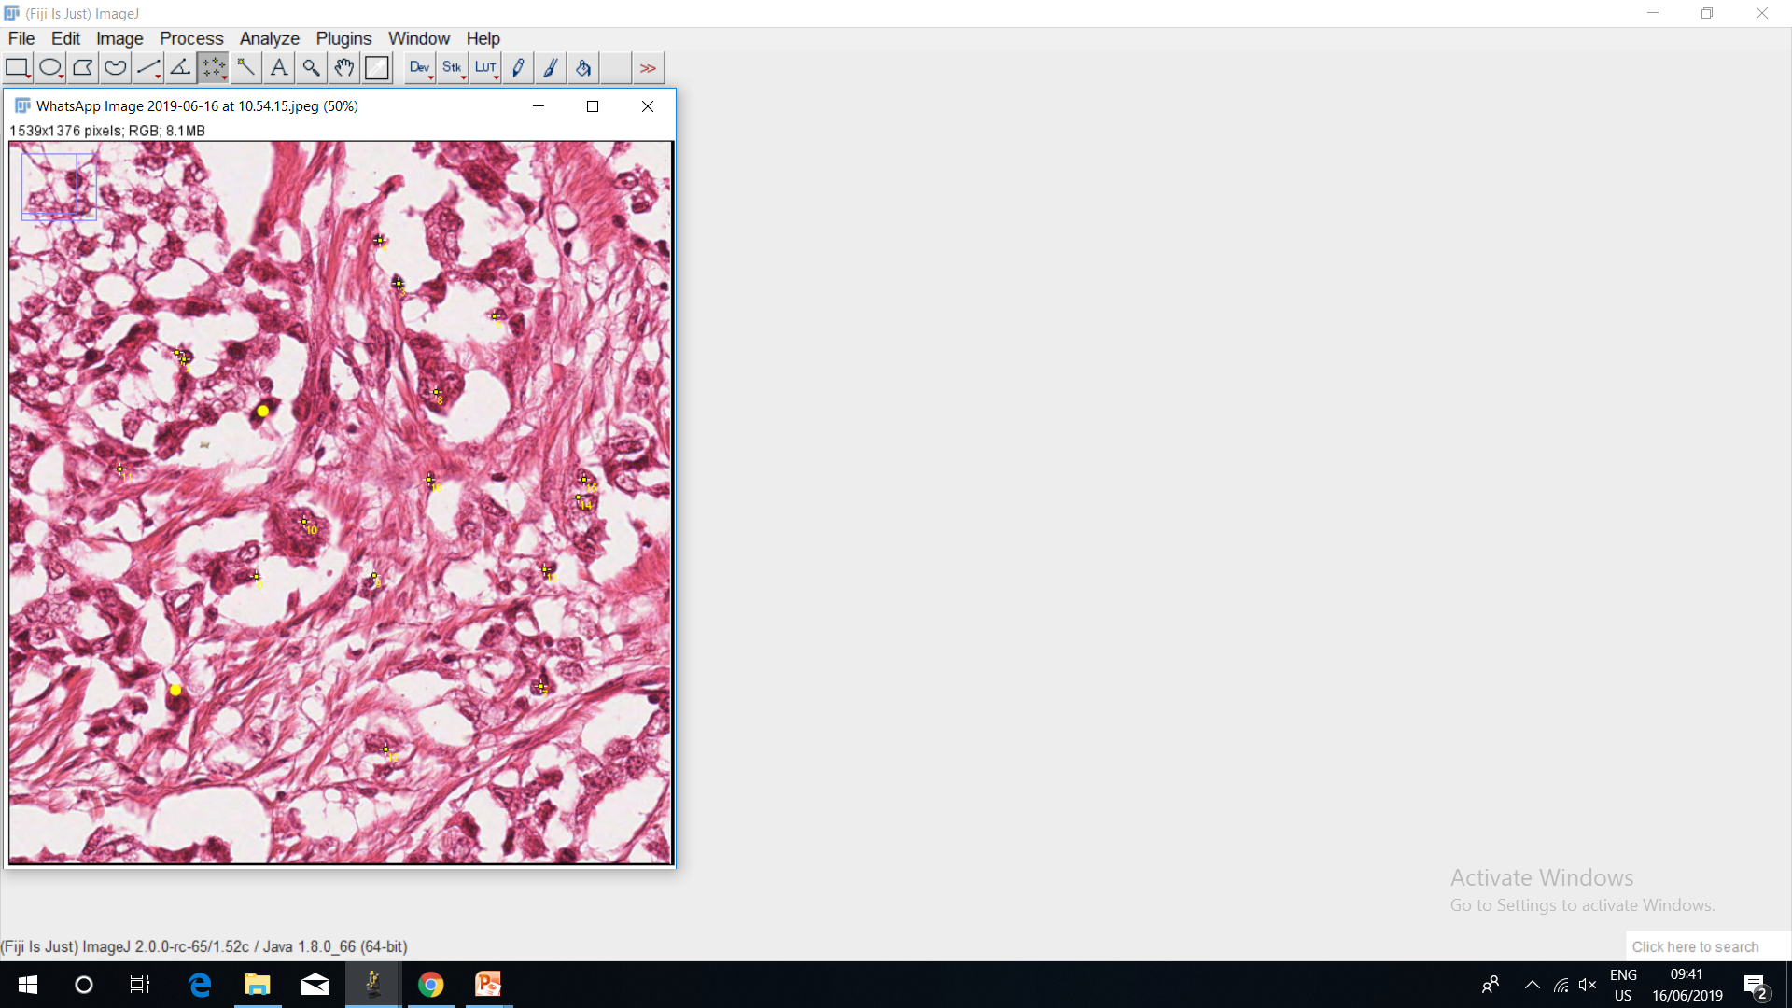
Database: TUPAC16
Image Size:256x256
Batch:1
Channels:3

Slide 23
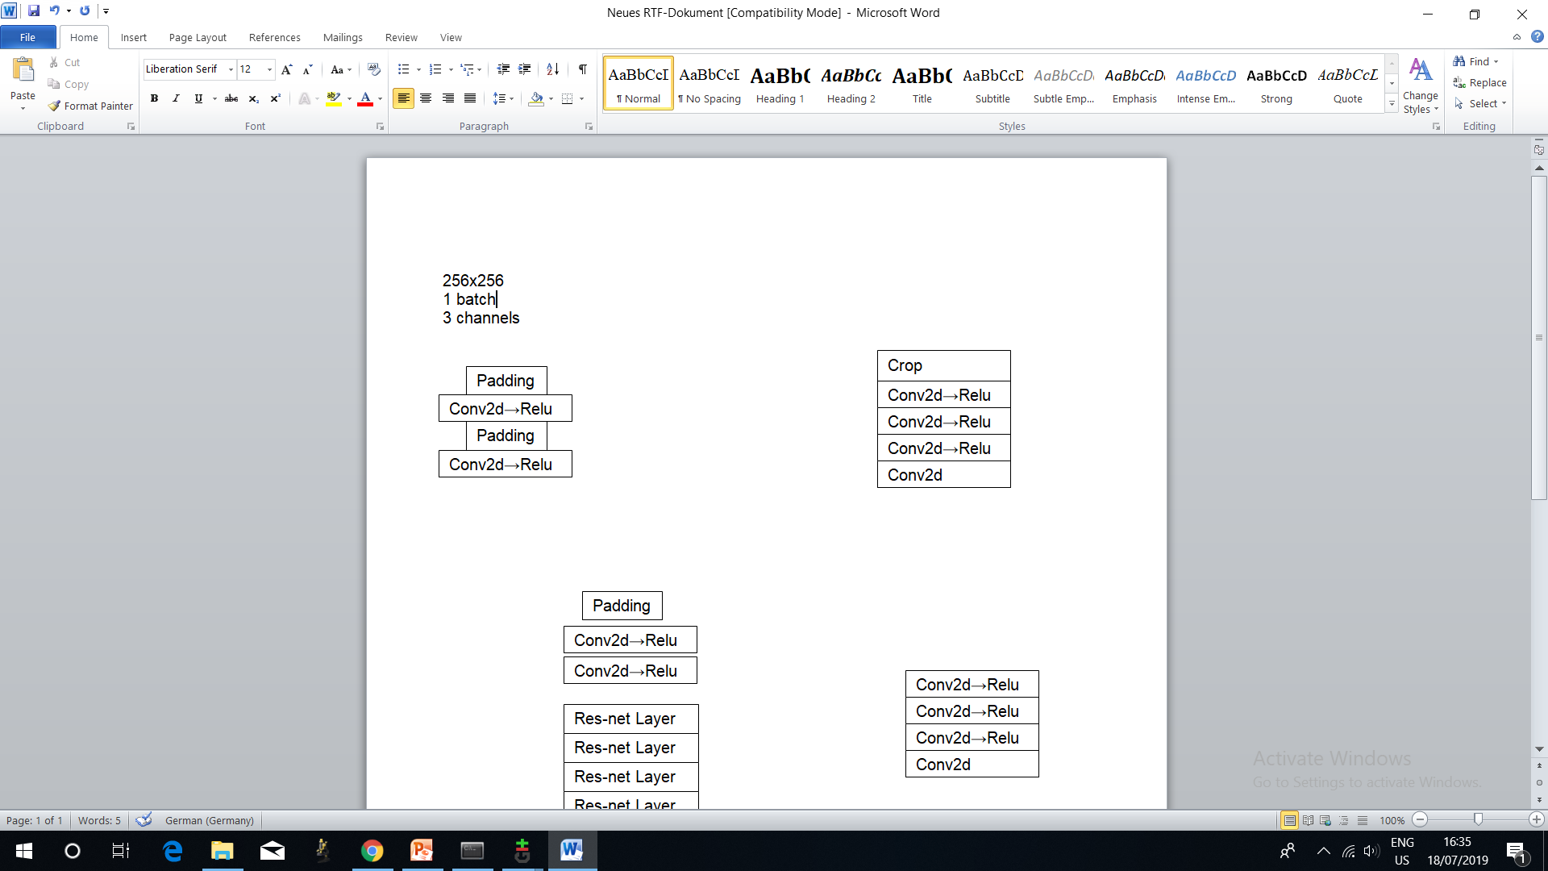
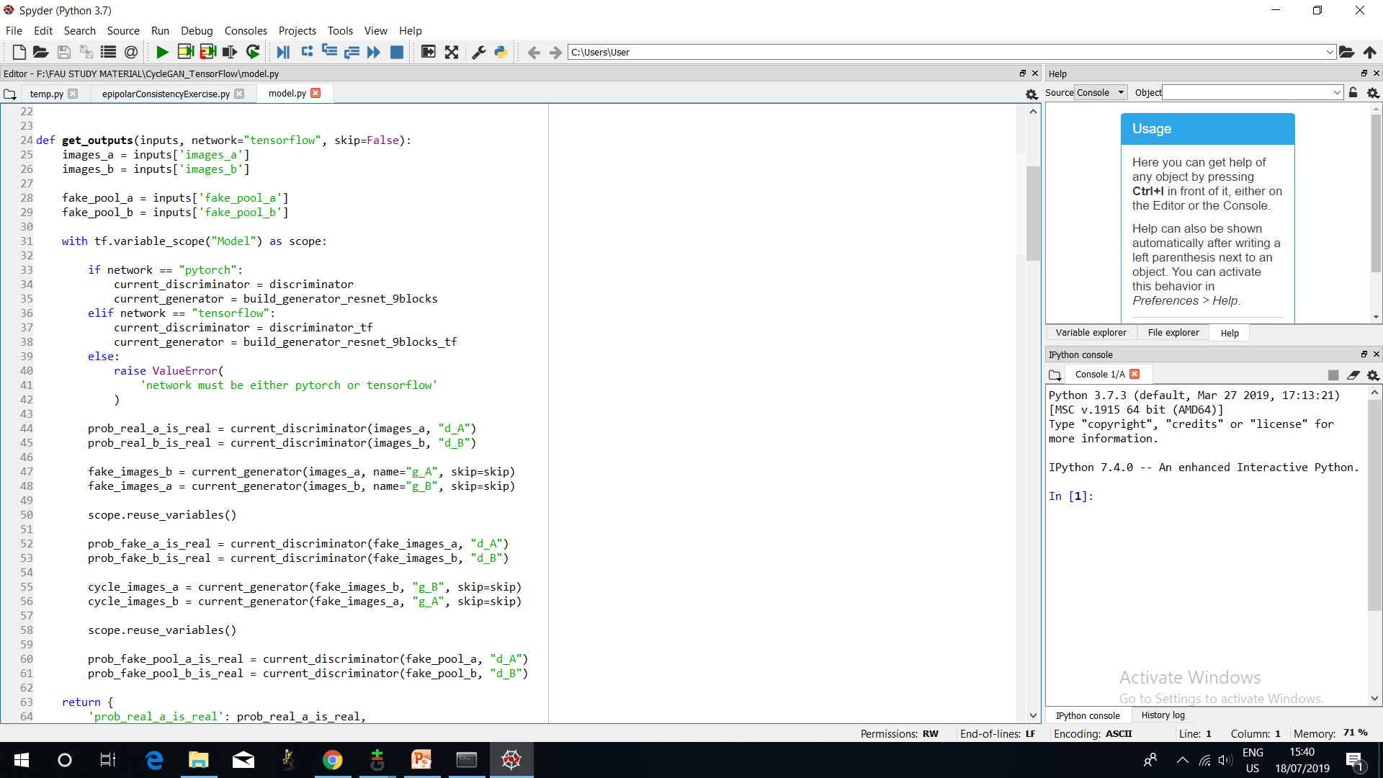
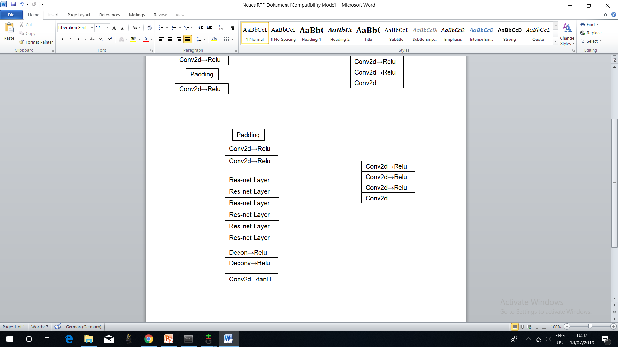
Res-net Discriminator Patch-Discriminator
Generator
https://github.com/leehomyc/cyclegan-1

Slide 24
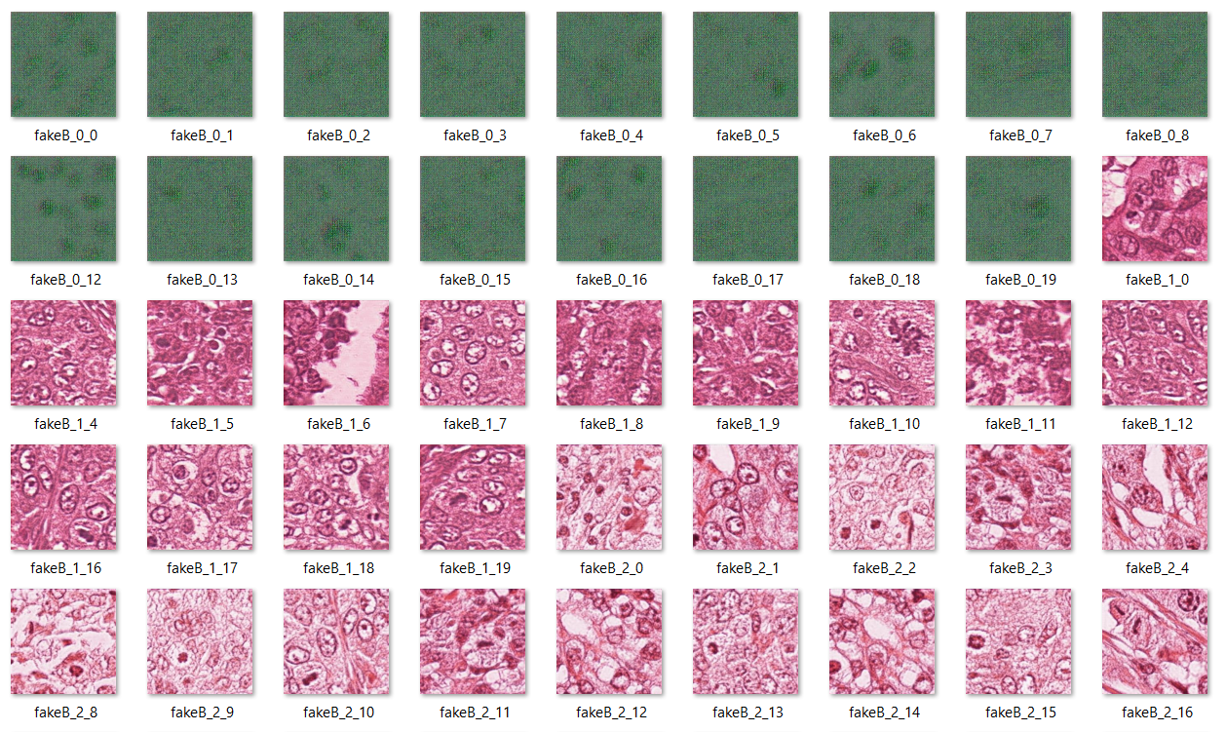
Our Trial for Artificial Mitotic Images

Slide 25
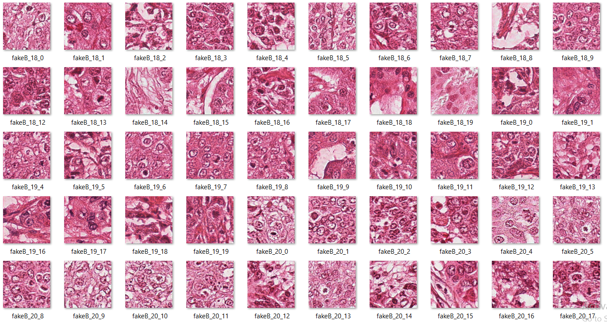
Does the Magic Happen?

Slide 26
Does the Magic Happen?

Slide 27
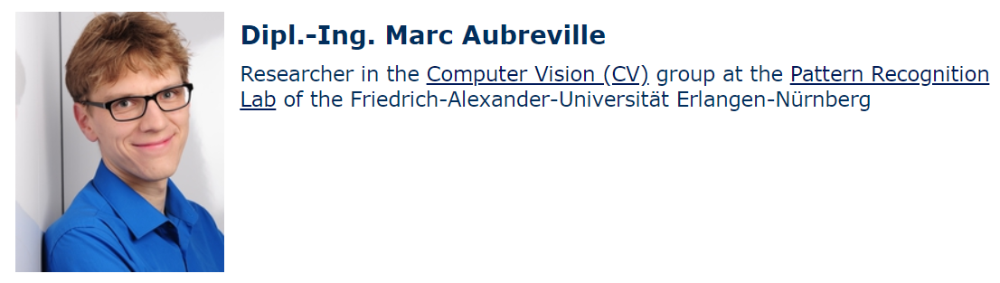
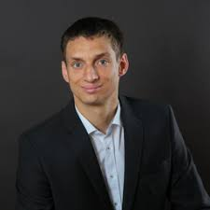
Experts Feedback in an Interview
Christian Marzahl M. Sc.
Researcher in the Computer Vision (CV) group at the Pattern Recognition
Lab of the Friedrich-Alexander-Universität Erlangen-Nürnberg

Slide 28
Why Fake Images for Annotation!!!
Mitotic data is available only for specific tissue types .e.g breast tissue, dog cells.
With fake Images, can we achieve more generalisation , i.e data for organs where mitotic data is not that widely available?
Finally, our game would work both on fake and real data and the approach is not limited to mitosis….

Slide 29
Problems:
User labels might vary for same images.
How can we trust the labels!!!
Solution:
We need a trust score model.

Slide 30
Data Analytics
Trust score development
Motivation of individual and institutes
Visualise overall performance

Slide 31
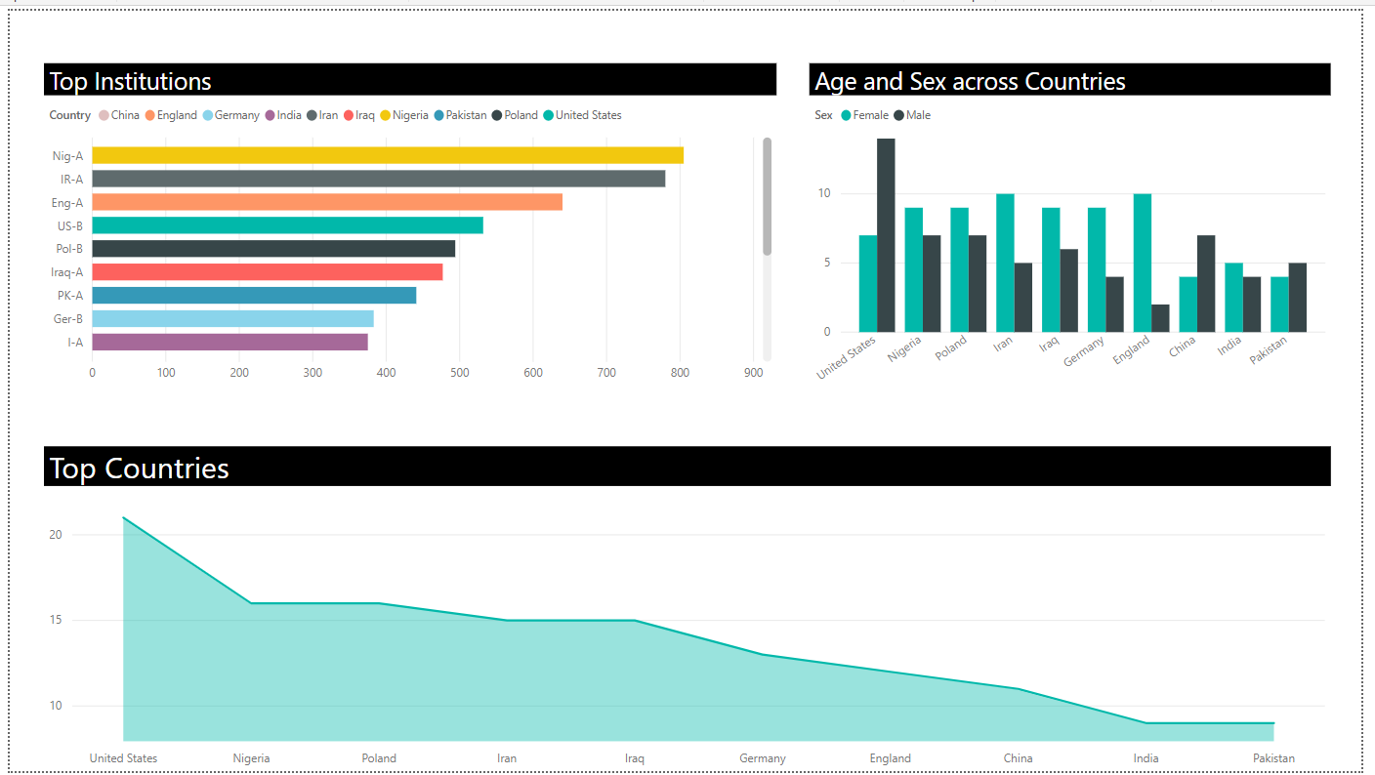
Key Performance Indicators Dashboard

Slide 32
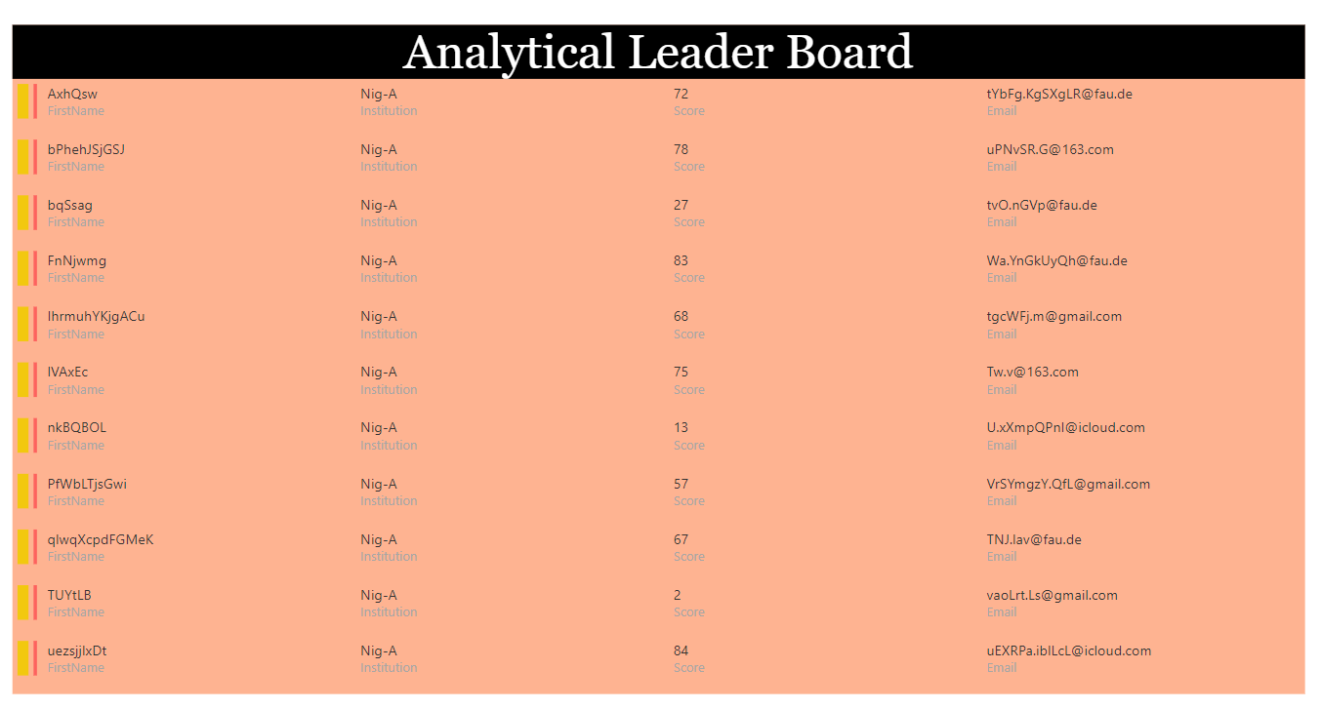
Leader Board- Key Performance Indicators

Slide 33
Accomplishments
Design of game level system
Fully-built database
Tutorial and level 1 of the game
Part of level 2 game control
Fake images generated by cycleGAN

Slide 34
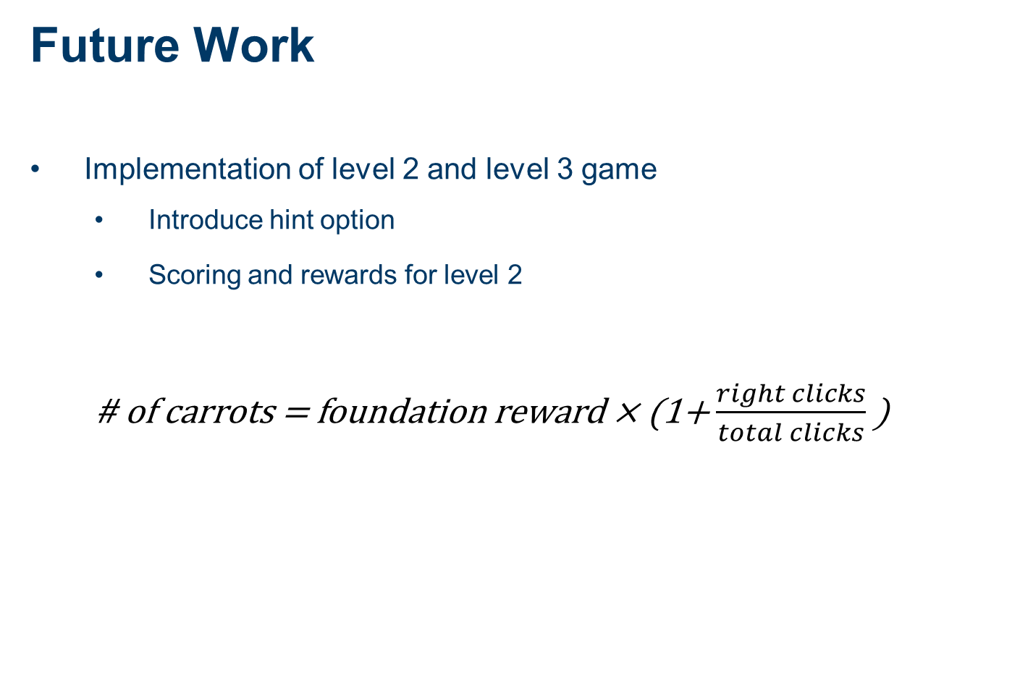
Future Work
Implementation of level 2 and level 3 game
Introduce hint option
Scoring and rewards for level 2
# of carrots = foundation reward × (1+ $\frac{right clicks}{total clicks}$)

Slide 35
Future Work
Implementation of level 2 and level 3 game
Introduce hint option
Scoring and rewards for level 2
League mechanism for level 3
Players get certain number of unannotated data during the season
Players get stable rewards after completing annotation of an image
After the season, compute the labeling result by majority voting and user ranking
Users get additional reward based on their ranking

Slide 36
Future Work
Crowdsourcing in the backend
Compute individual trust score according to user performance
User trust score
Moving average of user score
User age
Institution

Slide 37
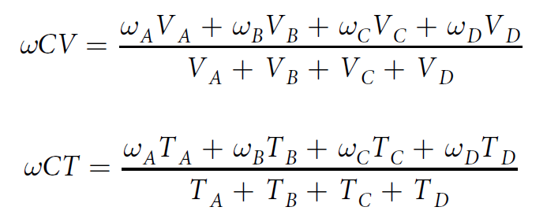
Future Work
Crowdsourcing in the backend
Compute individual trust score according to user performance
Aggregation
Maximum weighted crowd votes (ωCV)
maximum weighted crowd trust scores (ωCT)

Slide 38
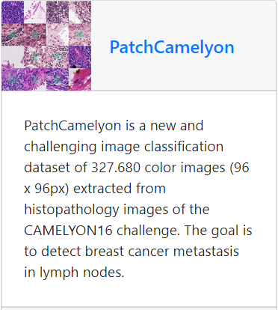
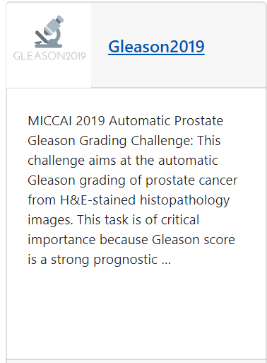

Future Work
Extend to other fields
Similar approach for labeling can easily extend to other tasks

Slide 39
Contribution Table
Umer | Swipeable view(GUI) Swiping functionality Click function to locate mitosis
Wenyu Zhang | Scene design UI design Registration control Background music Trust Score Model
Srijeet | CycleGAN implementation Database(JSON file to CSV) UI design Analytics Dashboard for Trust Score, Motivation
Mingxuan Gu | Database connection Leaderboard scene(control) Registration scene(control) Image preprocessing User data storage
Zhaoya Pan | Image preprocessing Scoring system design Scoring and rewards implementation Load images to view

